Slide 1

Analysis of Health and Disease and E-Medicine Center
𝐎𝐧𝐌𝐞𝐝𝐢
Online Healthcare Platform

Slide 2

Project Idea
System Analysis & Design
CSE-306
Name: Asraful Islam Kajol Name: Farah Naj Islam Chowdhury ID : 18101082 ID : 18101103

Slide 3

outline
Problem statement
Objective of the system
Feature of the system
Resources
Revenue/ Benefit

Slide 4
Problem statement
In this age of information technology, we are still standing in line for various medical services. It is time consuming for busy and ordinary people. If they had an online platform for medical & medicine services , it would have saved time and physical energy.

Slide 5
Objective of the system
The main objective of this project is to build a platform for patient to collecting information of disease, consult with consultant and advise from doctors how to relief from disease and buy prescribed medicine easily. Patient will get unique interface where they can avail everything support in one site . This website will act as unique and secure way to perform to share all type of disease-knowledge & try to relief from that.

Slide 6







OUR SERVICES/Features
Disease symptoms analysis form with verifying result.
Appointments system for online and offline meet up
Create a profile with patient's problem overview.
Get all category's Doctors details and involved consultant profile.
Buy prescribed medicine and home delivery service.
Online payment system.
Patient sharing problems and doctors will give advice and prescribed medicine via text/audio/video call.
Area based ambulance details.
Health tips.
Notification alert..
Saving Time.

Slide 7
Resources
For any company there we need to use some resources to start for the setup of a website. For Analysis of health and disease and medicine center . We need money, manpower, experienced consultant, doctors information to start this service work.
For any startup we need money to start and maintain the website and manpower is must to start any service work.

Slide 8
Revenue
Subscription fee (monthly)
Advertisement
Percentage of appointment fee
Private consultation hour charge
Sell prescribed medicine via website

Slide 9


Requirements Analysis

Slide 10
Survey Details
Our project is “Analysis of Health and Disease and E-Medicine Center” which is based on dealing medical services. we are conducted our project by surveying the general public to see what they thought and expected about our project.
For this we have created a Google Form where we invited people for participating in our survey via E-mail and other social media platforms.
More than 125 people have responded in our survey and we made an analysis report based on the responses.
Link : shorturl.at/lqCFR

Slide 11
Worksheet
Age?
Occupation?
Do you think symptoms form analysis report is believable?
Can this service make our lives much easier?
Do you think this platform is more helpful than others?
Which category of people will more benefit to use this service ?
Do you think online process is more comfortable than manual process?
Do you think online medicine center service is more easier and faster than manual service?
Which payment method will you prefer?
Are you interested in using our services in the near future?
By this service is possible to prevent time wastage ?
Do you have any suggestion?

Slide 12
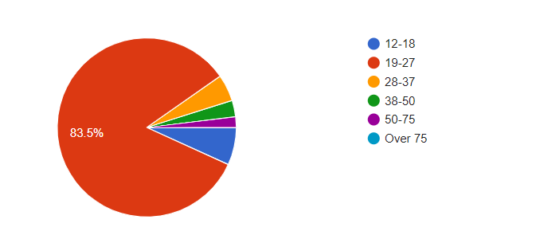
Statistical Analysis Age?

Slide 13
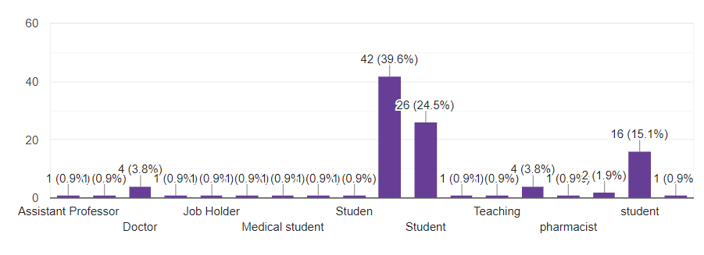
Statistical Analysis Occupation?

Slide 14
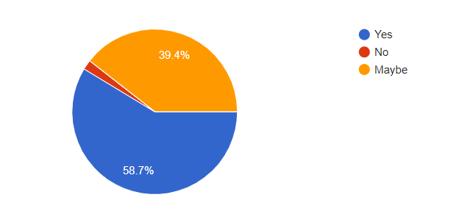
Statistical Analysis Do you think symptoms form analysis report is believable?

Slide 15
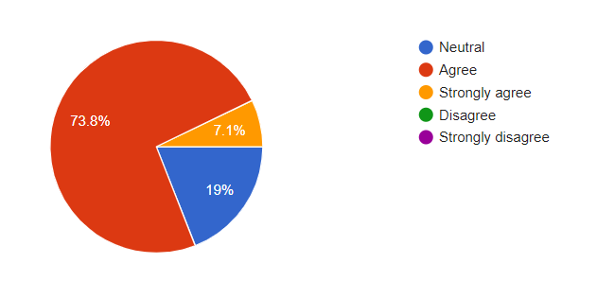
Statistic analysis Can this service make our lives much easier?

Slide 16
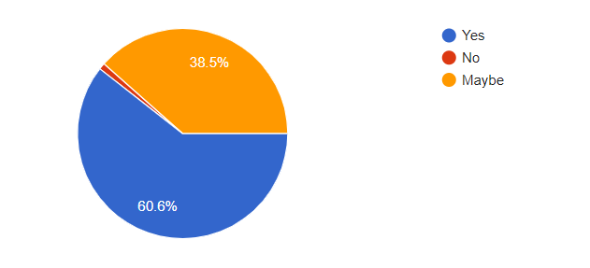
Statistic analysis Do you think this platform is more helpful than others?

Slide 17
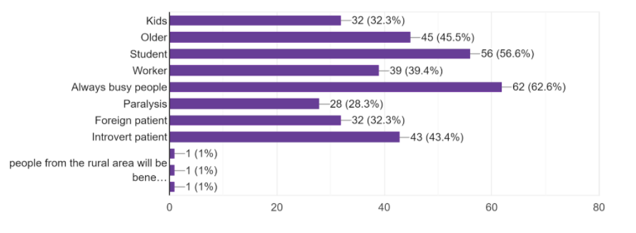
Statistic analysis Which category of people will more benefit to use this service ?

Slide 18
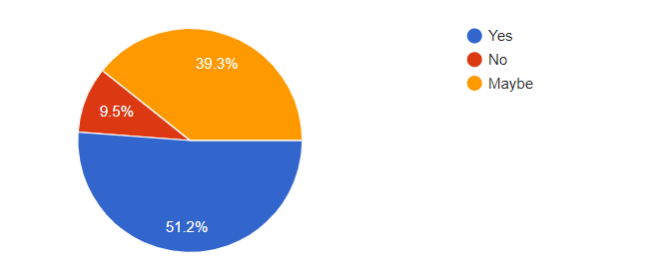
Statistic analysis Do you think online process is more comfortable than manual process?

Slide 19
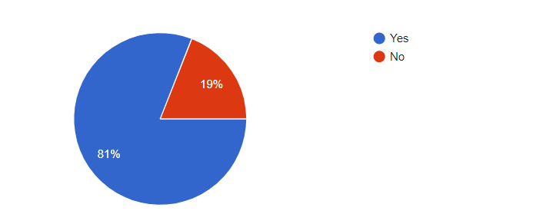
Statistic analysis Do you think online medicine center service is more easier and faster than manual service?

Slide 20
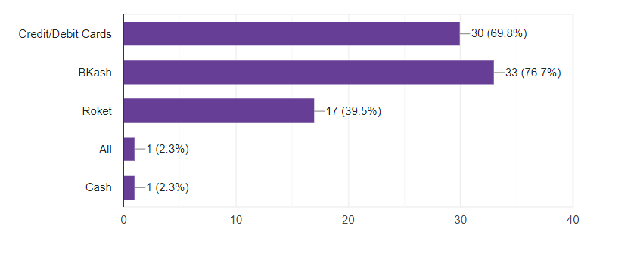
Statistic analysis Suggestions
WHICH PAYMENT METHOD WILL YOU PREFER?

Slide 21
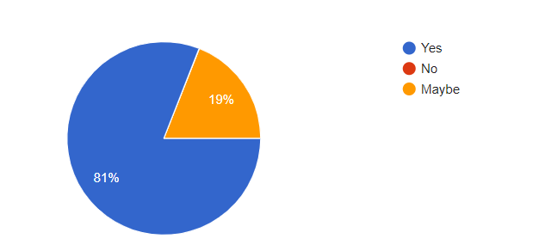
Statistic analysis Are you interested in using our services in the near future?

Slide 22
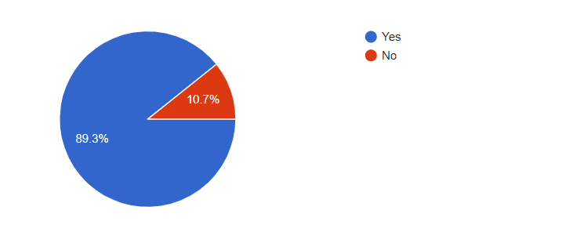
Statistic analysis By this service is possible to prevent time wastage ?

Slide 23
Statistic analysis Do you have any suggestion? Suggestions
Suggestion
24/7 service Add emergency services
This initiative is quite impressive. Hope to see this soon visible.
In case of comfort and time saving, online process is suitable. But in case of accuracy, it is very important to have a check physically by a doctor.
I think it'll be helpful
Make sure the service is more Reliable and secure
Keep it up..
Make it more secure and more professional .Best wishes.

Slide 24
Analyzed Requirements Suggestions
In this online survey ,we got a lots of response from people . They have expressed hope on this service. But they also have some requirements. That's are……
24/7 service
Emergency services
Wants more reliable and secured service
Wants to more professional service
Wants to accuracy of check up service

Slide 25
Updates
We will focus on its reliability, accuracy and security .
We will add 24 hours emergency service .
We will contacts with medicine company & shops for served more
faster and all time available service .
We Will try our best effort to update of this whole services .

Slide 26
Analysis of Health and Disease and E-Medicine Center
𝐎𝐧𝐌𝐞𝐝𝐢
Online Healthcare Platform

Slide 27
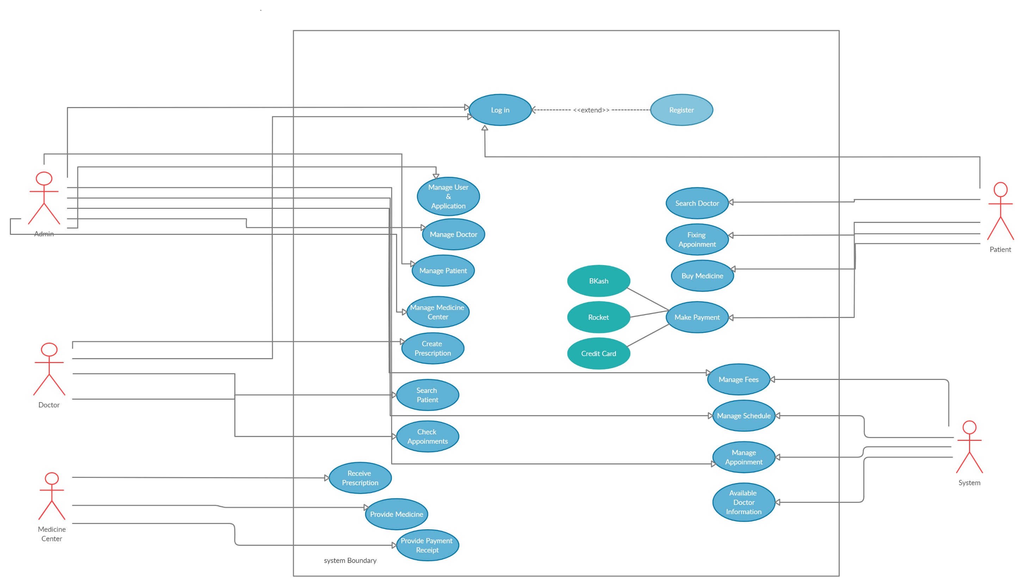
Case Diagram
Case Diagram

Slide 28
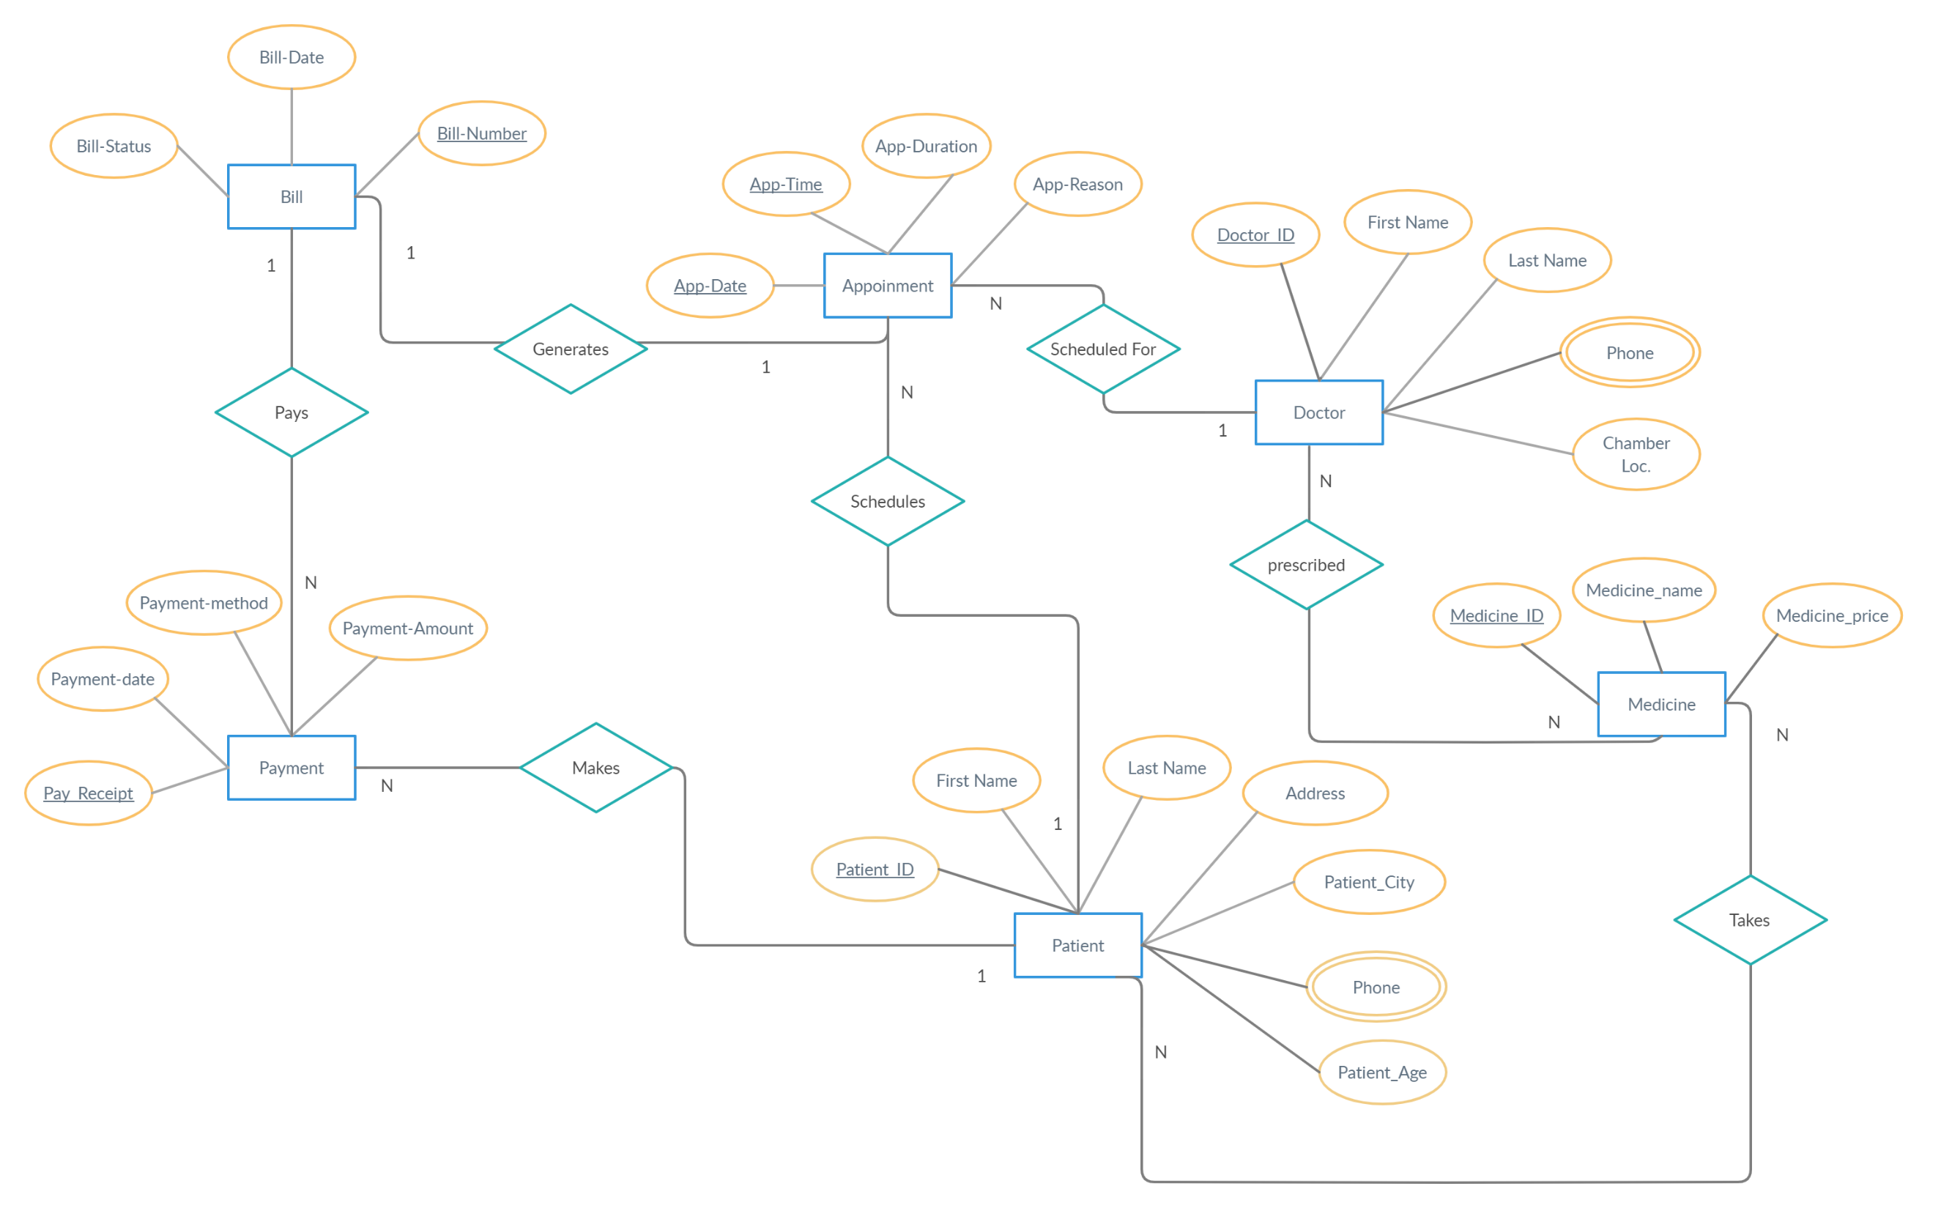
ER Diagram
ER Diagram

Slide 29
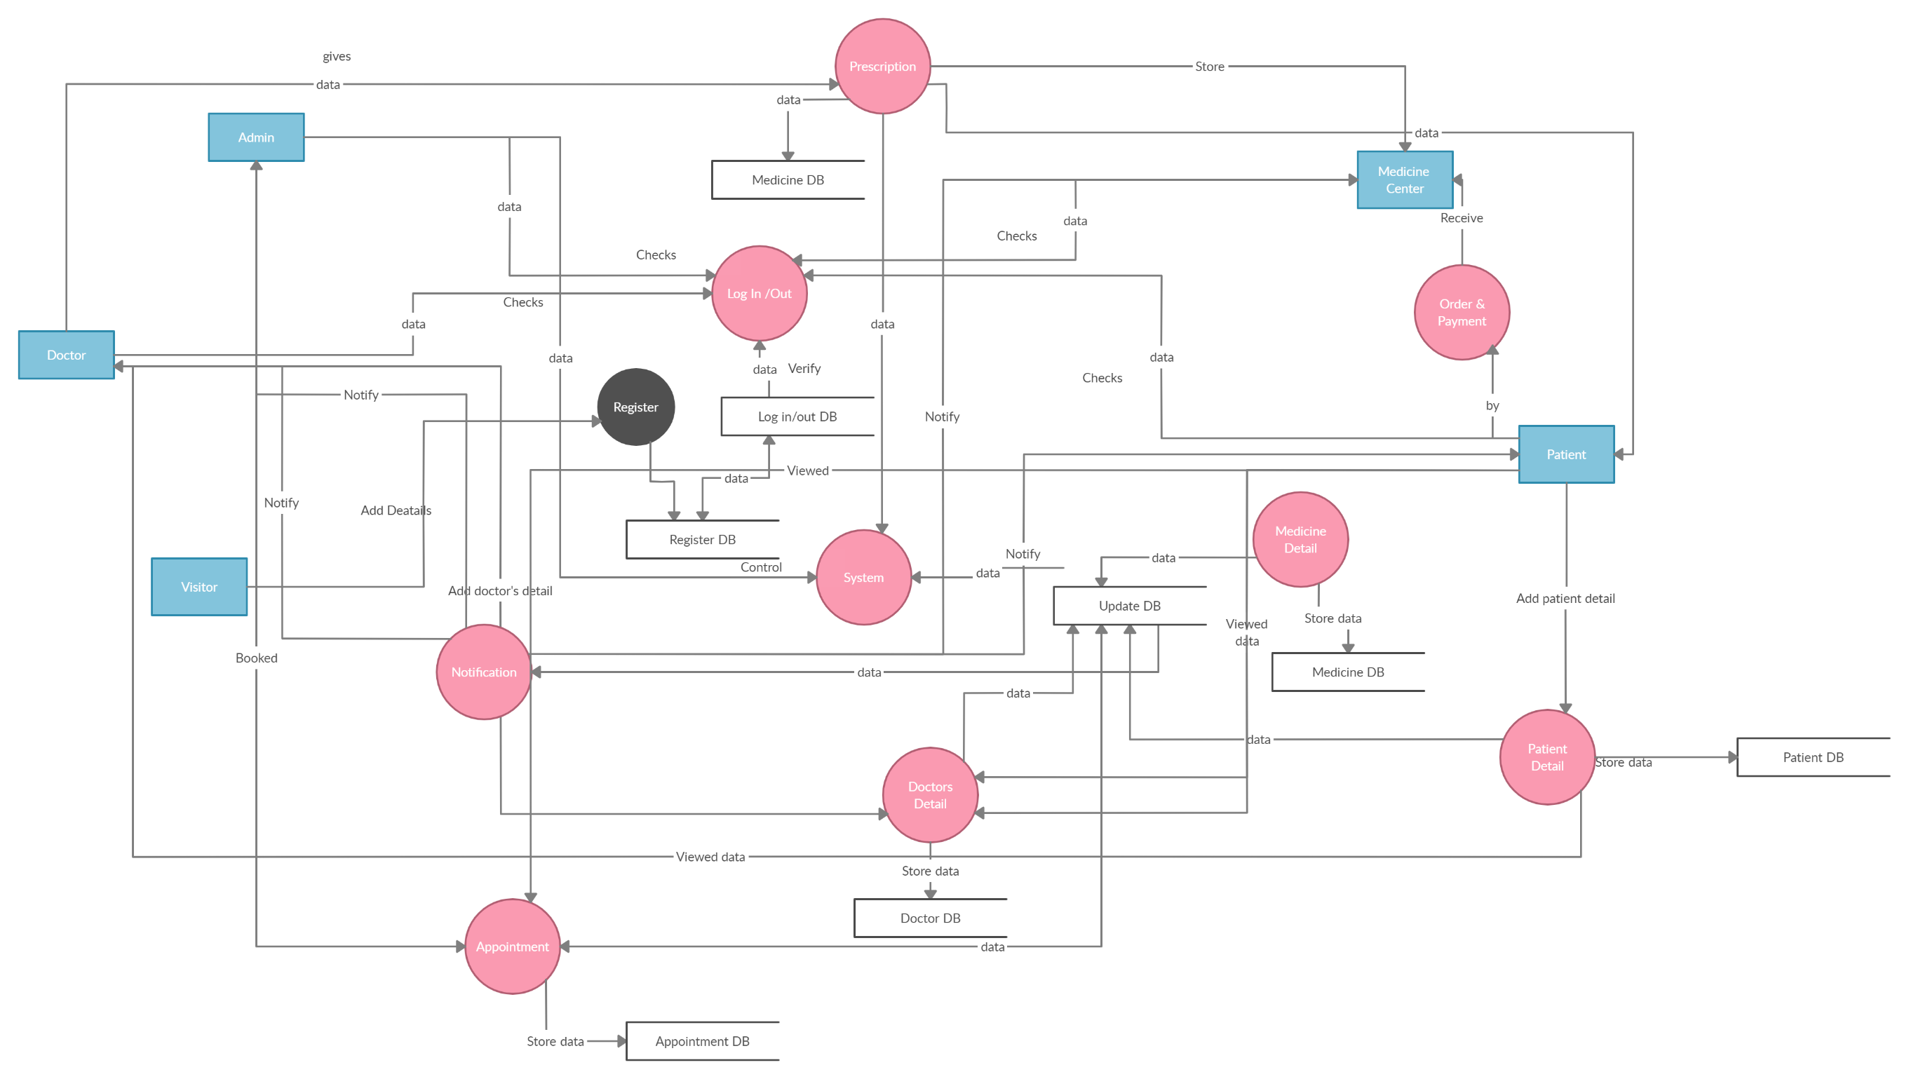
ER Diagram
DFD Diagram

Slide 30

Thank You
Any Question??

